Slide 1
API Builder Standalone
Tech Enablement Demo
#axway

Slide 2
Welcome To Our Presentation
Agenda for today
Introduction to API Builder
What’s new?
Data connector microservices
Swagger connector microservices
Containerization
Google Kubernetes Engine integration

Slide 3

Standalone
API Builder is a tool that enables developers to rapidly create APIs and microservices.
With a powerful opinionated framework for building APIs and a point-and-click technology, API Builder enables you to build containerized APIs and integrate data across diverse data sources with a low-code/no-code approach.

Slide 4
What’s New?
Standalone
New CLI
Plugin
New Plugins
No longer requires the AppC CLI or the Appcelerator Cloud.
Can be used on it’s own or in any environment of choice.
Lightweight CLI for generating new projects.
@axway/api-builder
Quicker to get from 0 to microservice.
Everything is a node module.
Out-of-the-box plugins are available from NPM.
Expect additional sharable component types in the future.
All previously available flow-nodes.
HTTP Rest client flow-node.
Swagger plugin: Create a flow-node from a swagger document.

Slide 5
What’s New?
Logging
Revised Configuration
12 Factor App
Logging to stdout by default
Allows for better integration with third party log aggregators.
API Builder is now environment-less and will run the same in any environment.
Configuration has been reduced in complexity to default/local files.
Made improvements based on principals which describe apps which play nice as SaaS.
https://12factor.net

Slide 6
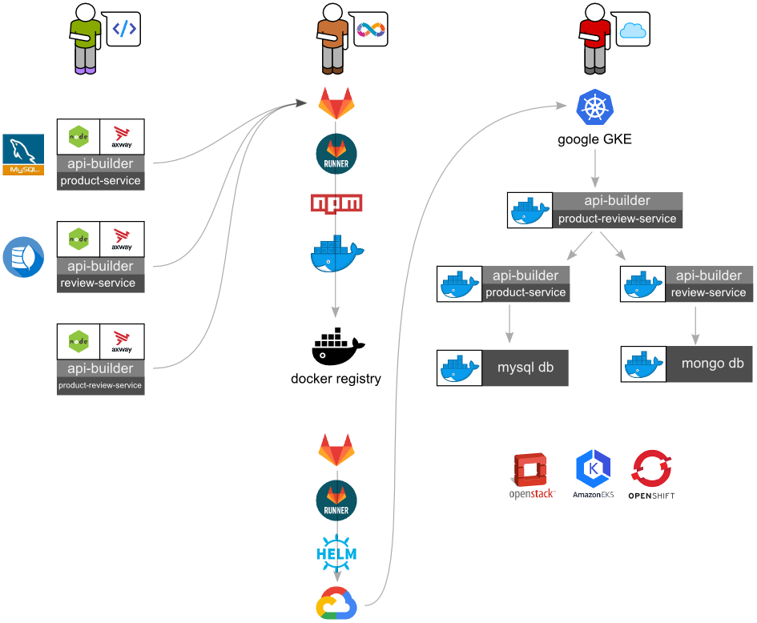
Standalone
API Builder is not opinionated about how or where your microservices are deployed.
@axway/api-builder CLI for creating new projects and getting started quickly
API Builder helps you rapidly develop microservices that you can then integrate into your standard DevOps build system and deploy to the environment of your choosing.

Slide 7
Plugin Architecture
Previously:
Connectors from AppC CLI & Appcelerator cloud.
Now node modules
Npm
Yarn
Git
Local
etc…
The node modules are plugins for API Builder, and can extend functionality, such as adding data connectors, or flow-nodes to the flow editor.
A 12-factor app:
Explicitly declare and isolate dependencies

Slide 8
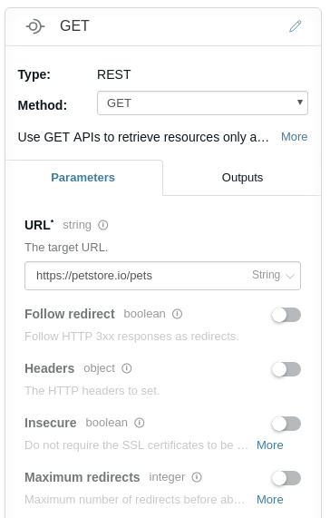
HTTP REST flow-node
API Builder now has a new flow-node that can connect to external services asynchronously via HTTP.

Slide 9
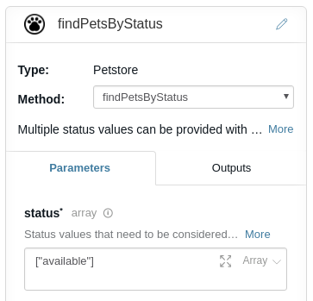
Swagger Plugin
API Builder now has a new plugin that can load Swagger 2.0 documents as flow-nodes and make them available to the flow editor.
Simplifies east-west communication to sibling services in a service mesh.
Simplifies communication to any service which has a Swagger 2.0 definition
There are many services which have Swagger specifications already

Slide 10
Custom Plugins
The ability for users to extend the functionality of the product is an important aspect to API Builder.
Robust
Reusable
Pluggable
The axway-flow-sdk is available to create flow-node plugins.

Slide 11
Logging
Previously, API Builder wrote to a logs directory. - Not useful for log aggregation services.
Now, it streams to stdout. – Easy integration with services such as Splunk
12-factor application:
Treat logs as event streams

Slide 12
Environments & Configuration
API Builder has simplified configuration with two sets of configuration files called default and local.
Environment variables recommended for customization
12-factor application:
Store config in the environment
Keep development, staging, and production as similar as possible

Slide 13


Monolith to Microservices
The customer use case for the demo

Slide 14
Monolith to Microservices
The customer has a monolithic application that no longer meets their needs. They heard about the free Axway API Builder and want to try out.
The customer has analyzed their monolith and decided to extract the Product Service and the Review Service which are owned by separate departments and using different data sources.

Slide 15
Monolith to Microservices
The customer also knows that with API Builder microservices, they can
Quickly deliver new and interesting business value
Maintain, deploy and scale much easier
Utilise their existing assets
They create a new Backend For Frontend (BFF) microservice (Product Review Service) that provides new value.
The customer will use GKE and helm to deploy the services.

Slide 16

Data Driven Microservices
How do we consume data from databases within an API Builder service?

Slide 17
Data Connectors
Allow you to create microservices that can interact with the data in your existing RDBMS and NoSQL datastores.
Create Models from the schema of your datastore.
Provide standardized CRUD methods for interacting with the datastore.
Seamless integration with orchestrated flows.

Slide 18
What data connectors are available?
For the API Builder 4.0 GA there are 3 connectors immediately available.
Mongo DB: @axway/api-builder-plugin-dc-mongo
MySql DB: @axway/api-builder-plugin-dc-mysql
Oracle DB: @axway/api-builder-plugin-dc-oracle
Additional support for other data connectors will be added based on demand.

Slide 19
Data Connectors: Install
Data Connectors are regular NPM modules and can be installed using npm.
npm install @axway/api-builder-plugin-dc-mongo

Slide 20
Data Connectors: Configuration
Data Connectors create a configuration file in the projects /conf folder.
module.exports = {
connectors: {
mongo: {
connector: '@axway/api-builder-plugin-dc-mongo',
url: 'mongodb://localhost/mydb',
generateModelsFromSchema: true,
modelAutogen: false
}
}
};

Slide 21
Demo

Slide 22


Inter-service Communication
How do we consume data from third-party APIs within an API Builder service?

Slide 23
Inter-service Communication
East-West Communication
Microservices talking to other services in the service mesh.
North-South Communication
Microservices calling out to remote third-party services.

Slide 24
API Builder v3 – Connector Builder
Very manual process.
Get the Swagger for the API, or write your own.
Generate a separate project for the connector.
Add the project to your CI.
Publish that project to NPM registry.
Install the published module in your project.

Slide 25



API Builder Swagger Flow-Node Plugin
Swagger
Configure
Flow
Get the Swagger for the API, or write your own.
Place the swagger into the service ./swagger folder.
Configure the service details (e.g. API Key).
Create a Flow using the generated Flow Node.

Slide 26
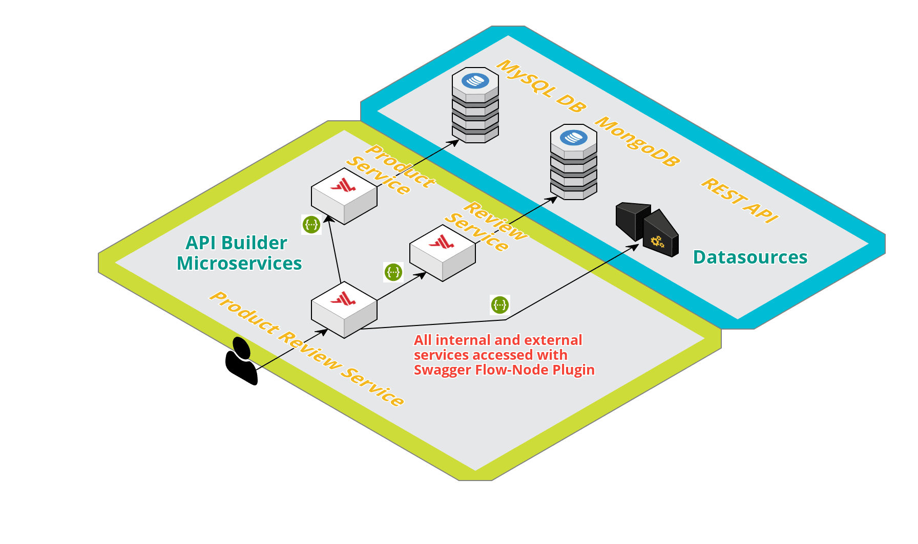
Demo

Slide 27
Demo

Slide 28

Containerization

Slide 29
Containers
Flexible: Even the most complex applications can be containerized.
Lightweight: Containers leverage and share the host kernel.
Interchangeable: You can deploy updates and upgrades on-the-fly.
Portable: You can build locally, deploy to the cloud, and run anywhere.
Scalable: You can increase and automatically distribute container replicas.
Stackable: You can stack services vertically and on-the-fly.

Slide 30
Environmentalization
The developer decides what configuration settings are exposed for configuration.
Keeps secrets out of the configuration files at rest.
Use process.env in the configuration files to access the environment.
When launching the environment variables can be passed in making the container reusable for different environments.
Allows promotion of the container, e.g. from test to production.

Slide 31
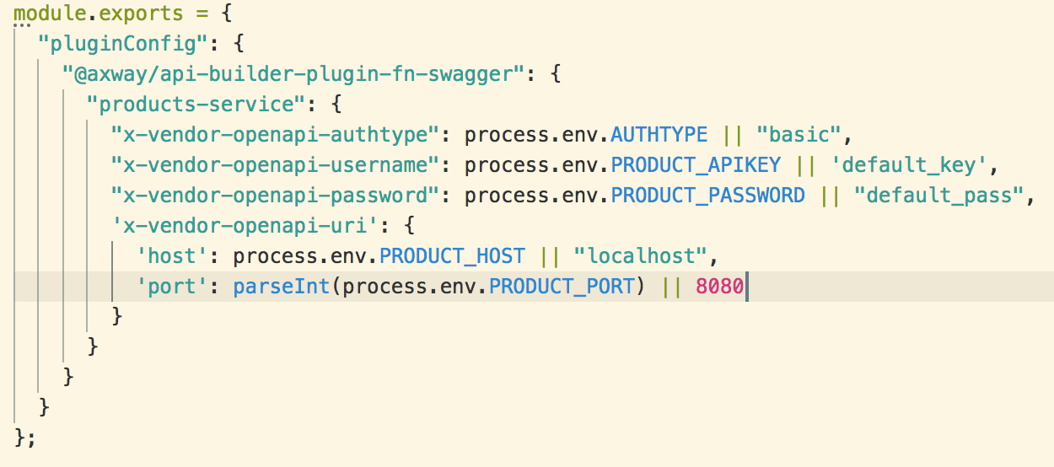
Environmentalization Example

Slide 32
Dockerfile
All API Builder projects come with a ready made Dockerfile.
FROM node:8-alpine
COPY . /app
WORKDIR /app
RUN npm install --production --no-optional
CMD ["node", "."]

Slide 33
Building an API Builder Container
docker build -t my-image-name .
docker build -t axway/api-builder-v4-demo-mysql project/mysql
docker build -t axway/api-builder-v4-demo-mongo project/mongo
docker build -t axway/api-builder-v4-demo-product project/product-service
docker build -t axway/api-builder-v4-demo-review project/review-service
docker build -t axway/api-builder-v4-demo-product-review project/product-review-service

Slide 34
Demo

Slide 35

Tech Enablement Demo

Slide 36
Demo - Reprise

Slide 37
Demo Setup
2 Databases
3 Microservices
5 Docker containers
22 Environment variables

Slide 38
Docker Compose
product:
image: "axway/api-builder-v4-demo-product"
depends_on:
- mysql
environment:
- DB_HOST=mysql
- DB_PORT=3306
- DB_USER=root
- DB_PASSWORD=password
review:
image: "axway/api-builder-v4-demo-review"
depends_on:
- mongo
environment:
- DB_HOST=mongo
- DB_PORT=27017
- DB_USER=apibuilder
- DB_PASSWORD=apibuilder
product-review:
image: "axway/api-builder-v4-demo-product-review"
depends_on:
- product
- review
environment:
- PRODUCT_HOST=product
- PRODUCT_PORT=8080
- PRODUCT_APIKEY=productkey
- REVIEW_HOST=review
- REVIEW_PORT=8080
- REVIEW_APIKEY=reviewkwy
- PD_APIKEY=pdkey

Slide 39
Demo

Slide 40

Deploying to Kubernetes

Slide 41
Kubernetes 10,000ft
The Kubernetes features our basic deployment touches:
Container deployment orchestration – deploy services in the correct order.
Auto-scalability/Replication
Self healing with liveness and readiness probes.
Logging.
Multi-vendor support (GKE, AKS, Amazon EKS, Oracle).
Ingress/SSL termination
…

Slide 42
Kubernetes Resources
Pods are the smallest deployable units that can be created and managed. Each pod is a group of one or more containers.
Deployments allow you to declaratively define the relationship between ReplicaSets and Pods.
Services are an abstraction which defines a logical set of Pods and a policy by which to access them.
Ingresses manage external access to services in the cluster.

Slide 43
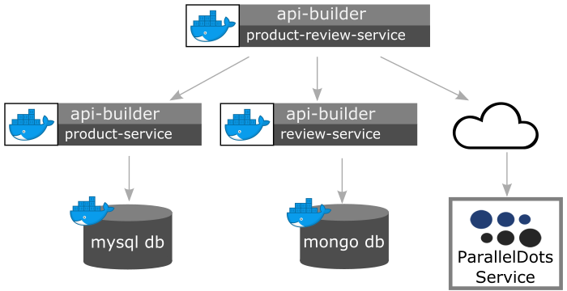
Solution Architecture

Slide 44
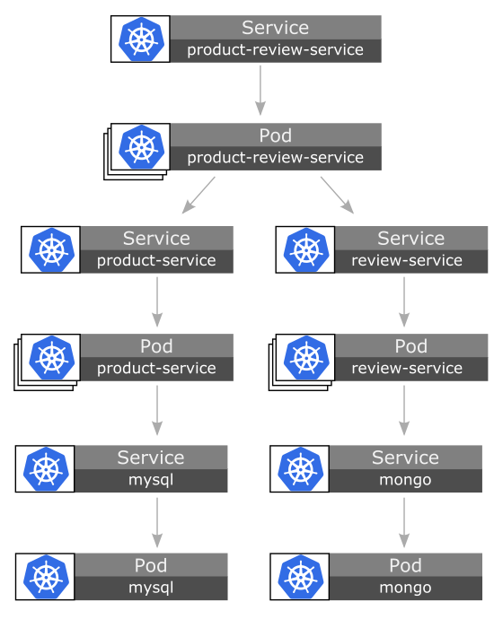
Demo Resources

Slide 45
Helm "the package manager for Kubernetes"
Charts to group all the resource files.
Templates for all the kubernetes resources.
Parameterization of templates for easy reuse.
Repeatability.
Installation is a single command.
helm install --name demo project/helm-product-review-chart

Slide 46
Demo
Deploy mongo db
Deploy mysql db
Deploy replicated Product Service
Deploy replicated Review Service
Deploy replicated Product Review Service
Only Product Review Service is visible outside the cluster
SSL termination at Ingress

Slide 47
Demo

Slide 48
Thank You!

Slide 49
Thank You
Start using API Builder today:
npx @axway/api-builder init my-awesome-service
Tech Enablement Demo and Documentation:
https://github.com/Axway/api-builder-standalone-tech-enablement
API Builder Documentation:
https://docs.axway.com/bundle/API_Builder_4x_allOS_en/page/api_builder.html
Teams: API Builder feedback team

